Slide 1
Angular Introduction

Slide 2
Agenda
What is a SPA?
Angular.JS Overview and Version Comparison
Node.js, npm, WebPack, Yarn
Angular Command Line Interface – Angular CLI
Bootstrapping Angular / Project Configuration using Node.js

Slide 3
What is a SPA

Slide 4
What is a Single Page Application (SPA)
A single-page application (SPA) is a web application that fits on a single page with the goal of providing a more fluent user experience similar to a desktop application
In a SPA, either all necessary assets like HTML, JavaScript, and CSS –
  is retrieved with a single page load, or
  resources are dynamically loaded and added to the page, usually in response to user actions
SPA‘s are often implemented using JavaScript Frameworks that use assync XMLHttpRequests like
  Ember.js / Knockout.js
  Angular JS
  React

Slide 5
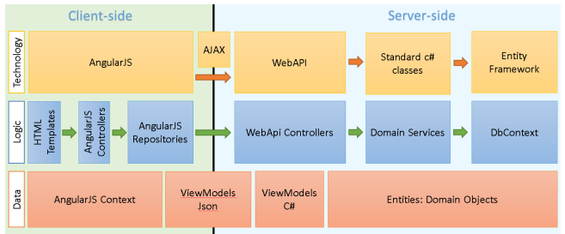
SPA Architecture
SPA‘s can be implemented using a combination of client- and server side technologies
Microsoft server side technologies often used together with SPA‘s are
  WebAPI
  ASP MVC
  Entity Framework (or Linq to SQL)

Slide 6
Comparing SPA / Multi Page Applicaiton (MPA)
SPA advantages over MPA:
  Faster page loading times
  Improved user experience because the data is loading in the background form server
  No need to write the code to render pages on the server
  Decoupling of front-end and back-end development
  Simplified mobile development; you can reuse the same backend for web application and native mobile application
SPA disadvantages to MPA:
  Heavy client frameworks which are required to be loaded to the client
  UI code is not compiled, so it’s harder to debug and it’s exposed to potential malicious user
  SEO (search engine optimization) implications; since your pages are built in the browser, the search engine crawler will see a different version of the page than that of your users

Slide 7
Angular Introduction

Slide 8
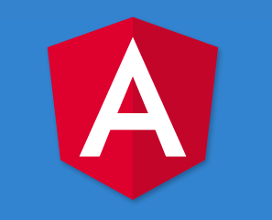
What is ANGULAR?
Defines numerous ways to organize web application at client side.
Enhances HTML by attaching directives, custom tags, attributes, expressions, templates within HTML.
Encourage TDD & Client Side MVC/MVVM design pattern
Good for Single Page Apps (SPA)
Current version 5 released Nov 01 2017
Mainly maintained by Google

Slide 9
Versions
Angular JS (1.0)
  Implemented mostly in pure JavaScript
Angular (2+)
  Complete Rewrite
  Drastic change between 1.x and 2.x
  Mostly Implemented in TypeScript
  Current Version 5.x

Slide 10

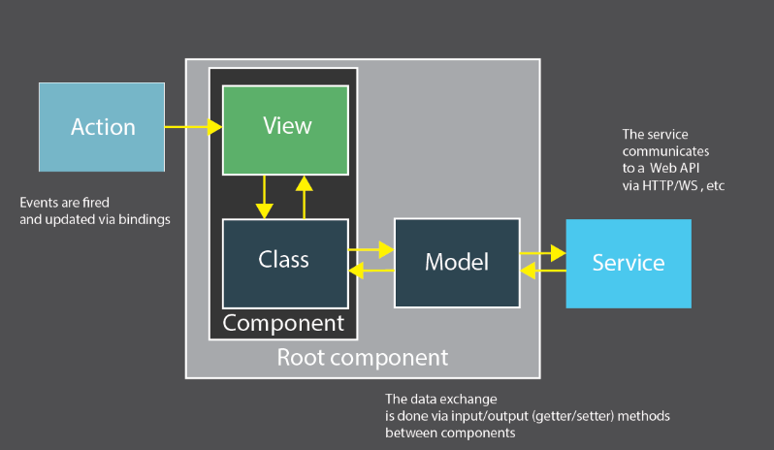
Components - Angulars MVC

Slide 11
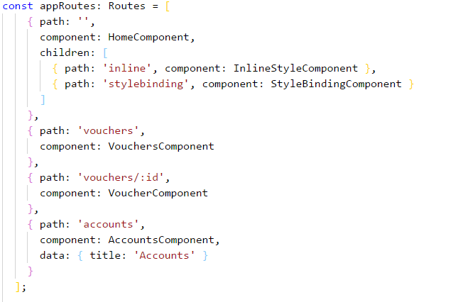
Routing
Routing is the process to switch from one view to another
Routing is archieved using Angular Router
Routing is configured in app.module.ts
Router Links are used for navigation
<nav>
<a routerLink="/" routerLinkActive="active">Home</a>
<a routerLink="/vouchers" routerLinkActive="active">Vouchers</a>
<a routerLink="/accounts" routerLinkActive="active">Accounts</a>
</nav>
<div>
<router-outlet></router-outlet>
</div>

Slide 12

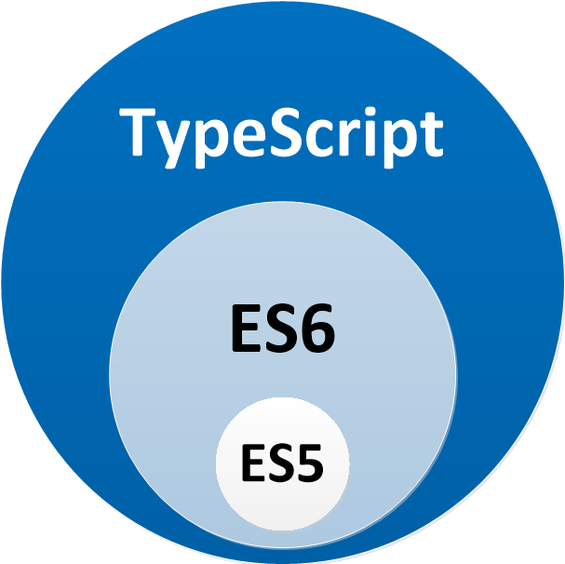

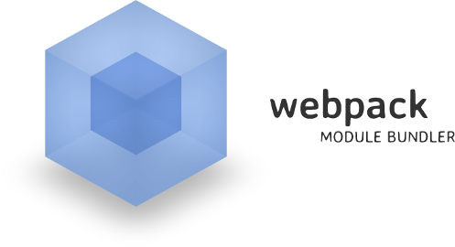

Angular Technology Stack
Runtime / Package Management: Node.js
Language: TypeScript (ES 6, Dart)
Templating / Dependencies:
Angular CLI, Yeoman, NPM, Yarn
Bundling: Webpack

Slide 13
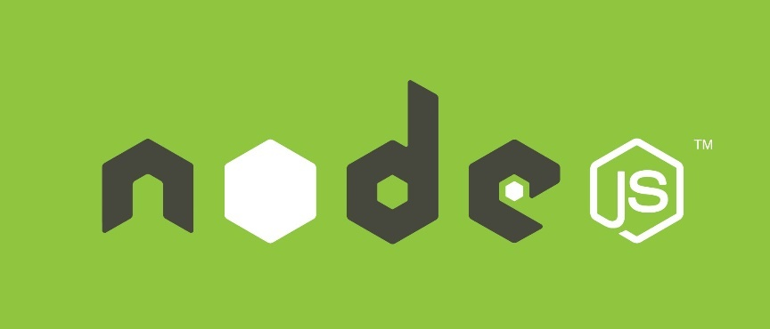
What is Node.js
Node.js is a platform built on Chrome's JavaScript runtime for easily building fast and scalable network applications
Uses an event-driven, non-blocking I/O model that makes it lightweight and efficient
Used to build:
  I/O bound Applications
  Data Streaming Applications
  JSON APIs based Applications
  Single Page Applications
Doku @ https://nodejs.org/en/

Slide 14
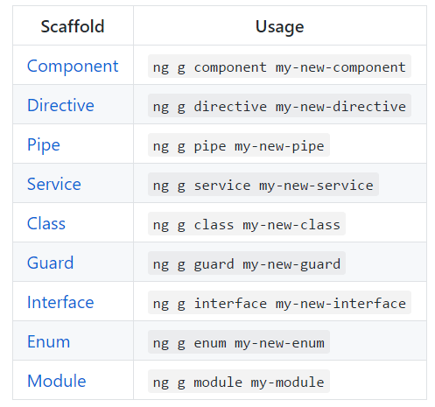
Angular CLI
Command Line Interface for managing Angular Applicaitons
Install using npm install –g @angular/cli
Basic commands
  Create new projects:
    ng new
  Create new components, services, ...
    ng generate component – shorcut: ng g c
  Serving
    ng serve
Documentation @ https://cli.angular.io/

Slide 15



Common Editors
Any Editor that has integrated Support for Node.js
Editor is many times result of Plugins available
  Visual Studio Code
  Atom, Sublime
  WebStorm
  Visual Studio Professional

Slide 16
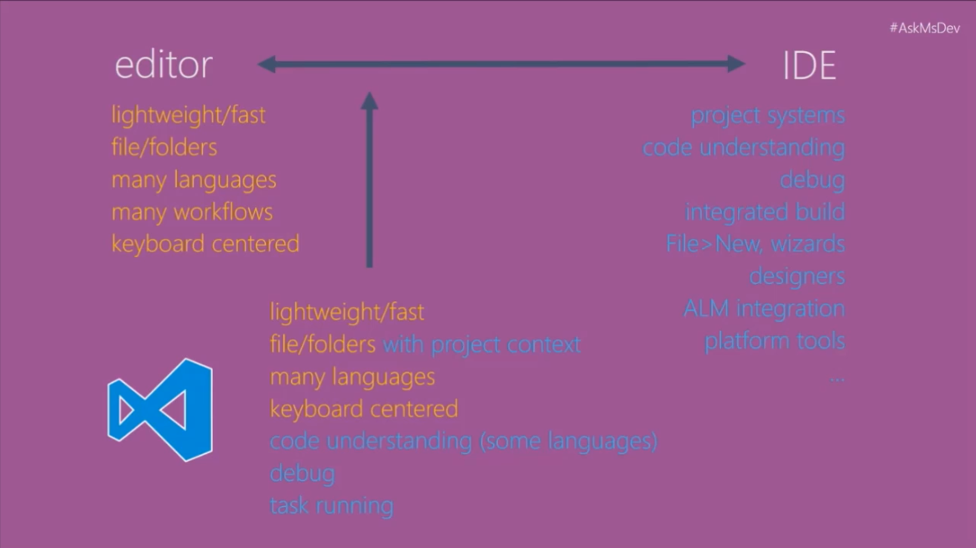
Visual Studio Code
Free, Open Source, lightweight cross plattform editor built on top up GitHubs Electron platform
Optimized to build HTML, JS, TS based applications
Out-of-box integration of GitHub & Node.js
Get from https://code.visualstudio.com/
Source @ https://github.com/microsoft/vscode
2nd Choice Editor would be Webstorm
https://www.jetbrains.com/webstorm

Slide 17
VS Code Shortcuts & Settings
Ctrl + P Quick open
Ctrl + Shift + F Find in Files
Ctrl + K, S Save All
Ctrl + ö Open Terminal Window
Shift + # Toggle Comment
Alt + Shift + A Toggle Block Comment
Complete VS Code Shortcute Guide:
https://github.com/Microsoft/vscode-tips-and-tricks
Useful Workspace Settings
"editor.wordWrap": "on"
"workbench.editor.enablePreview": false

Slide 18
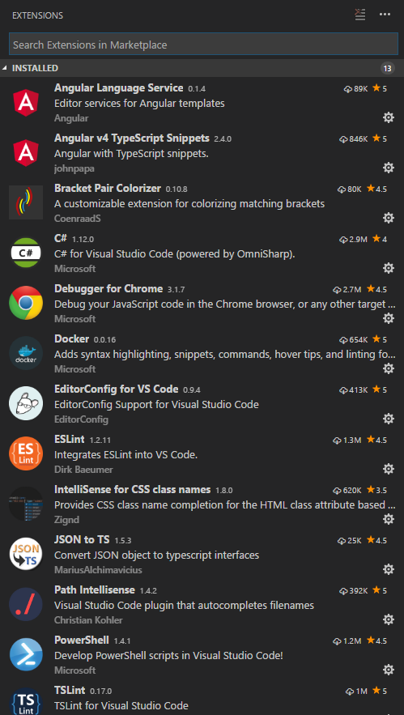
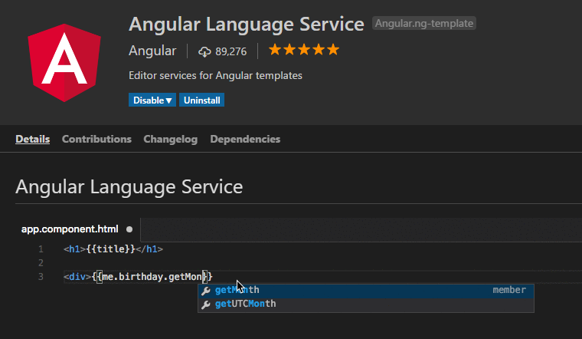
Usefull VS Code Extensions
Extensions make VS Code development easier
  Angular v5 Snippets
  Angular Language Service
  Debugger for Chrome
  IntelliSense for CSS class names
  Bracket Pair Colorizer
  Path Intellisense
  JSON 2 TS

Slide 19
Extension Management
List
  code --list-extensions
Install (VSIX install possible)
  code --install-extension NAME ie: Angular.ng-template
Uninstall
  code --uninstall-extension NAME ie: ms-vscode.csharp
Angular.ng-template
christian-kohler.path-intellisense
clinyong.vscode-css-modules
CoenraadS.bracket-pair-colorizer
DougFinke.vscode-PSStackoverflow
eg2.vscode-npm-script
formulahendry.auto-close-tag
johnpapa.Angular2
KnisterPeter.vscode-github
MariusAlchimavicius.json-to-ts
Mikael.Angular-BeastCode
ms-vscode.csharp
ms-vscode.PowerShell
msjsdiag.debugger-for-chrome
rafaelsalguero.csharp2ts
rbbit.typescript-hero
xabikos.JavaScriptSnippets

Slide 20
Node.js, Yarn, Webpack

Slide 21
What is Node.js
Node.js is a platform built on Chrome's JavaScript runtime for easily building fast and scalable network applications
Uses an event-driven, non-blocking I/O model that makes it lightweight and efficient
Used to build:
  I/O bound, Data Streaming Applications
  Data Streaming Applications
  JSON APIs based Applications
  Single Page Applications
Current version 8.0
Doku @ https://nodejs.org/en/

Slide 22
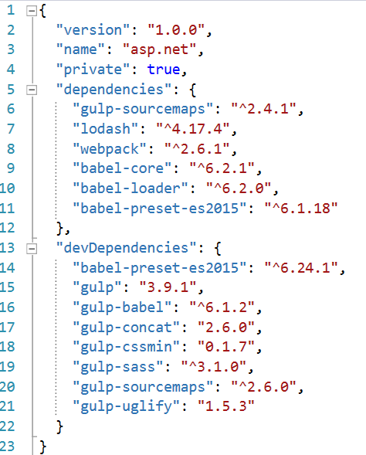
package.json
package.json is the configuration file for node.js
packages are saved to node_modules – name cannot be changed
npm install xxx [–g] –save | npm install xxx [–g] –save-dev
npm-shrinkwrap creates a npm-shringwrap.json which can
used to lock down package dependency

Slide 23
Node.js Basic Setup
Install Node.js from https://nodejs.org/
npm install –g xxx --> installs globally
Go to cmd of your project
Get Angular Seeder Project or create using Angular CLI: ng new xxx
npm install --> installs all dependencies listed in project.json
npm install –g typescript

Slide 24
npm – Node Packet Manager

Slide 25
npm
npm makes it easy for JavaScript developers to share the code
Esentially it acts as the package manager for node.js using the “install” cmd
Lots of other cli commands
  version
  build
  bundle
  start
Documented @ https://docs.npmjs.com/cli/install

Slide 26
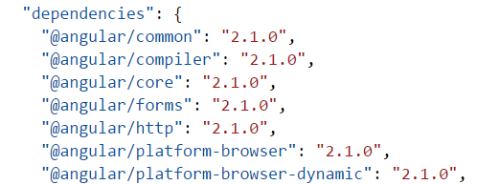
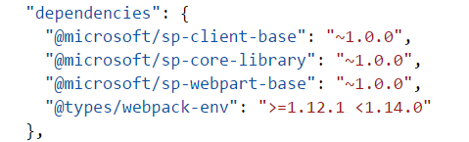
npmjs.com
npmjs.com is a centralized repository form packages
Allows to have private packages calles @scope (@microsoft/xx, @angular/xx)
Used in vendor packages like Angular, SharePoint Framework (SPFx)

Slide 27
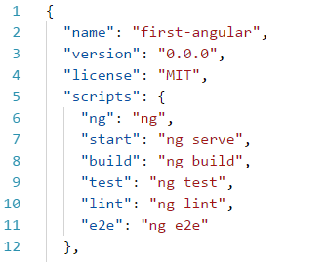
npm scripts
npm allows scripting to automate tasks – eg. Starting dotnet cli
Scripted cmds may be stated
  Inline
  External file

Slide 28
Semantic versioning - Semver
Major release, increment the first number, e.g. 2.0.0
Minor release, increment the middle number, e.g. 1.1.0
Patch release, increment the last number, e.g. 1.0.1
  >1.2.3 means greater than a specific version.
  <1.2.3 means less than a specific version.
  1.2.3 - 2.3.4 means >=1.2.3 <=2.3.4.
  ~1.2.3 means >=1.2.3 <1.3.0.
  ~1.2 means >=1.2.0 <2.0.0.
  ~1 means >=1.0.0 <2.0.0.
  1.2.x means >=1.2.0 <1.3.0.
  1.x means >=1.0.0 <2.0.0.

Slide 29
Yarn

Slide 30

Yarn
Replacement for npm that Speeds up Node based dev by downloading and caching packages more efficient than npm
Installation: npm install -g yarn
Npm install -> yarn
Npm install xxx –save -> yarn add xxx –save
Yarn can be set as global Package Manager for Angular
  ng set --global packageManager=yarn
Documentation @ https://yarnpkg.com/en/docs

Slide 31
Managing Yarn Cache
Yarn stores every package in a global cache in your user directory on the file system.
Speeds up creation / loading of Angular projects
print out every cached package
  yarn cache ls
print out the path where yarn’s global cache is currently stored
  yarn cache dir
will clear the global cache
  yarn cache clean
Set cache-folder – will be created if it does not exist
  yarn config set cache-folder <path>

Slide 32
Understanding Webpack

Slide 33

Webpack
A module bundler for the static assets in your Angular application
Transforms & creates bundles provided to the browser
Works on:
  JavaScript,
  Typescript,
  CSS,
  …

Slide 34
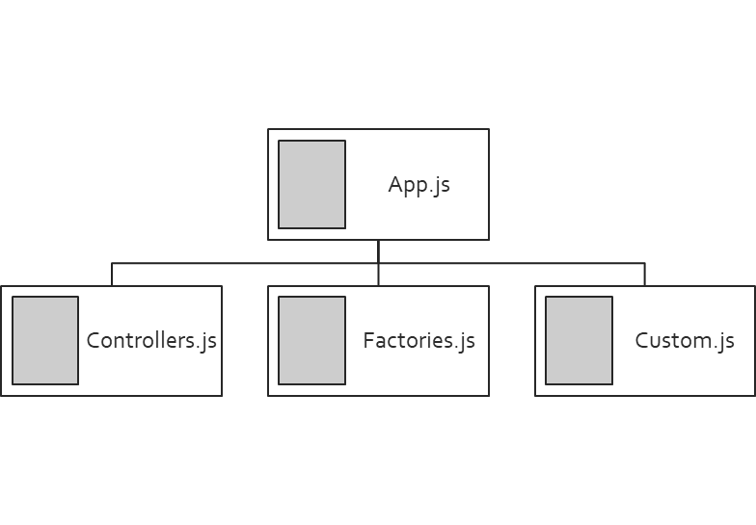
Dependency Graphs
require keyword is used to build dependency graphs
Example: require(' './wwwroot/app.js ');
Notes:
https://medium.com/@dabit3/beginner-s-guide-to-webpack-b1f1a3638460#.lmdev2tg2
http://blog.andrewray.me/webpack-when-to-use-and-why/

Slide 35
Installation
Webpack is installed by default in Angular CLI projects
Core elements installed using Node.js
  WebPack:
  npm install webpack –g
  WebPack Dev Server:
  npm install webpack-dev-server –g

Slide 36
webpack.config.js
Used to automate build
  __dirname refers to the directory where this webpack.config.js lives
  Entry: entry file of the app
  Output: file to generate
  Watch: use watcher
var path = require('path');
const webpack = require('webpack');
module.exports = {
entry: {
app: './wwwroot/app.js'
},
resolve: {
extensions: ['.js']
},
output: {
path: './wwwroot',
filename: 'js/bundle.js'
}
};

Slide 37
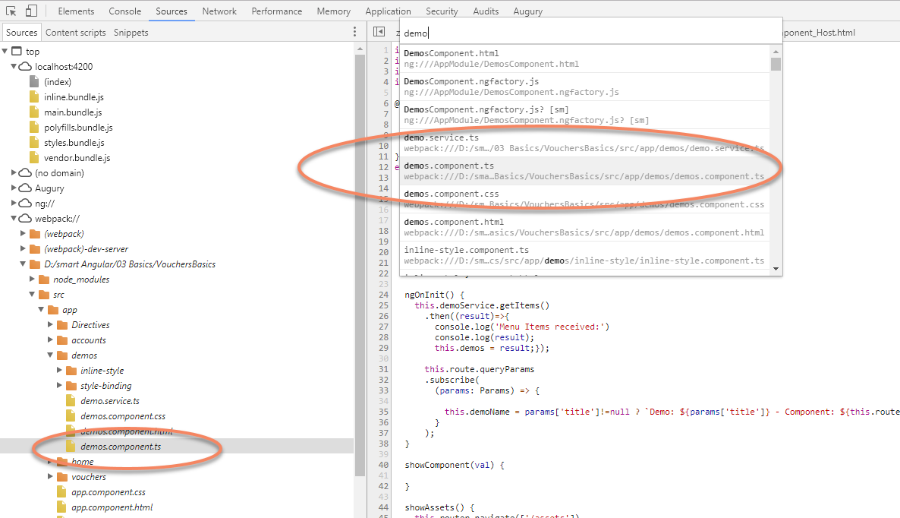
Angular Debugging into bundles
Use „Ctrl + o“ in Chrome Dev tools to directly navigate to a file you want to debug

Slide 38
Angular CLI

Slide 39
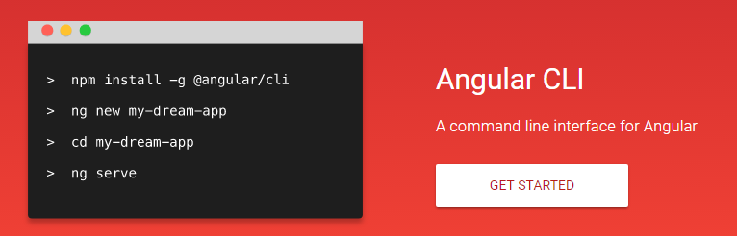
What is Angular CLI
Command Line Interface used to manage Angular projects
Installation
  npm install –g @angular/cli
Common Commands
  ng new
  ng generate
  ng serve
Documentations @ https://cli.angular.io/
Notes:
https://www.sitepoint.com/ultimate-angular-cli-reference/

Slide 40
.angular-cli.json
Configuration file for Angular CLI
Contains settings for
  root
  outDir
  testing
  linting
  assets

Slide 41
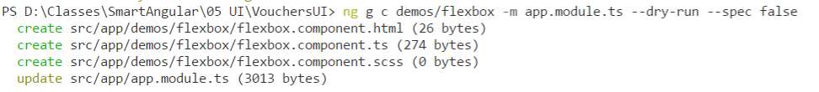
ng generate
Used to create Angular artifacts like
  class
  component
  directive
  enum
  guard
  interface
  module
  pipe
  service
General Syntax:
  ng generate component [name]
  ng g c [name]
See Expected Output: --dry-run
Do not create specs: --spec: false

Slide 42


Use Angular CLI with Yarn
By default Angular CLI uses NPM
To speed up DL time use Yarn instead
Can be achieved using ng set cmd
  ng set [key]=[value]
  ng set --global packageManager=yarn

Slide 43
ng serve / ng build
ng serve
  Uses webpack-dev-server
  Compiled output is served from memory, not from disk
  Does NOT include all project files
  Runs on http://localhost:4200 by default
  Runs in watch mode
ng build
  Writes output to dist/ folder

Slide 44
Update Angular
Customize to your needs!
npm install @angular/common@latest @angular/compiler@latest
@angular/compiler-cli@latest
@angular/core@latest
@angular/forms@latest
@angular/http@latest
@angular/platform-browser@latest
@angular/platform-browser-dynamic@latest @angular/platform-server@latest
@angular/router@latest
@angular/animations@latest
"@angular/cli"@latest
typescript@latest
--save

Slide 45
Bootstrapping Angular / Project Configuration

Slide 46
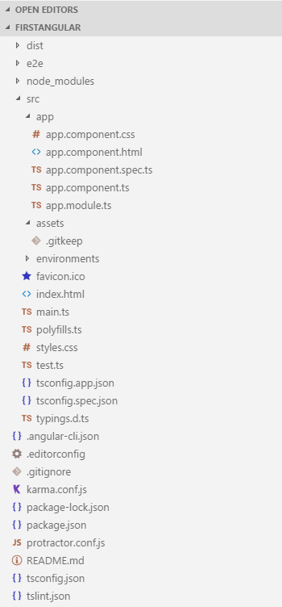
Project Structure
Configuration:
  package.json, tsconfig.json, typings.json
Boostraping:
  main.ts
App:
  app.module.ts
  app.module.ts

Slide 47
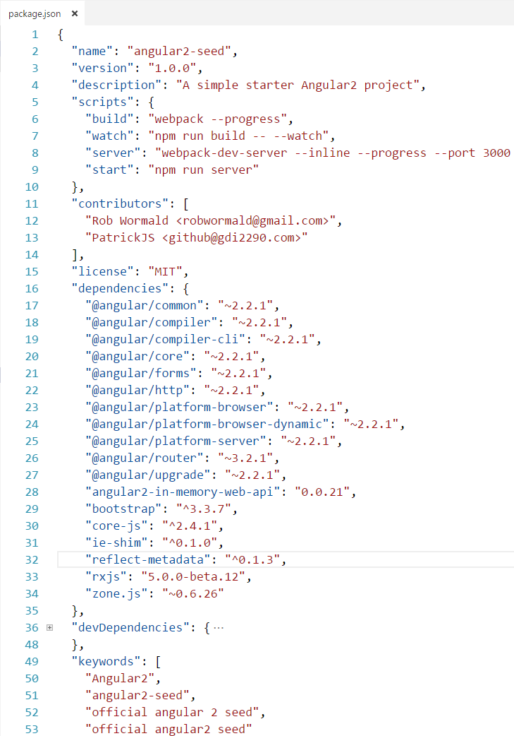
package.json
package.json is the configuration file for node.js
Packages are downloaded automatically, when file is saved
Consists of:
  Metadata
  Dependencies
  DevDependencies
  ... not installed using: npm install –production
  Scripts

Slide 48
Angular Dependencies
Angular has the following depedencies
  systemjs – Module Loading
  es6-promise – Promises to ES5
  es6-shim – Other missing ES6 functionality for ES5
  reflect-metadata – ES7 Decorators to ES5/ES6
  rxjs – Reactive extensions – Use observables insted of Promises
  zone.js – Event handling outside Angular

Slide 49
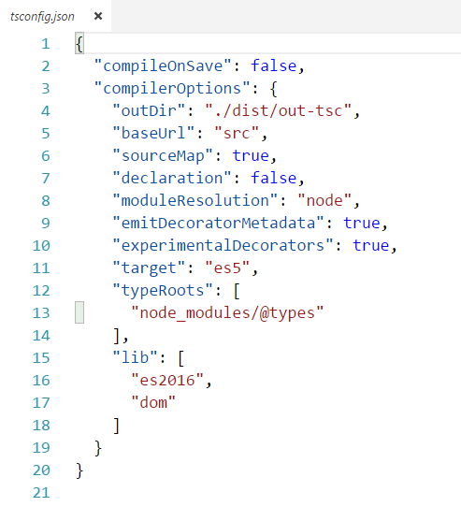
tsconfig.json
Indicates the root of a typescript project
Specifies the compiler options
Most common used settings
  sourceMap
  moduleResolution
  target

Slide 50
typings.json
References Typings used in project
Using TypeScript Definition Manager
  npm install –g typings
  typings install dt~jquery --save --global … dt corresponds to source – definitly typed
  Docu @ https://github.com/typings/typings
TypeScript 2+ pattern
  npm install @types/moment --save

Slide 51
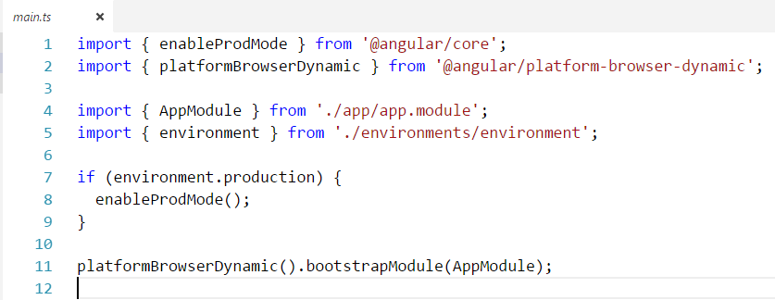
main.ts
Bootstraps the Angular Applicaiton
Load the AppModule

Slide 52
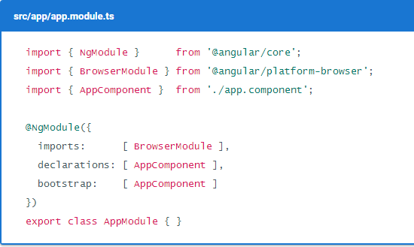
app.module.ts
The @NgModule decorator identifies AppModule as an Angular module class which is the root of an Angular app
All artifacts must be registered in the module so that they can be used
Consists of sections:
  Imports
  Declarations
  Bootstrap
  Providers

Slide 53
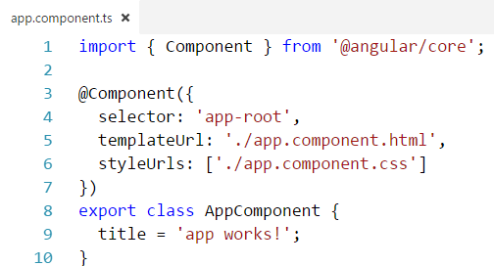
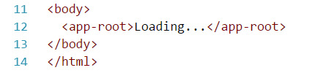
app.component.ts
Is the root component of an angular app used in your start page (index.html)
All other components are nested in this one

Slide 54
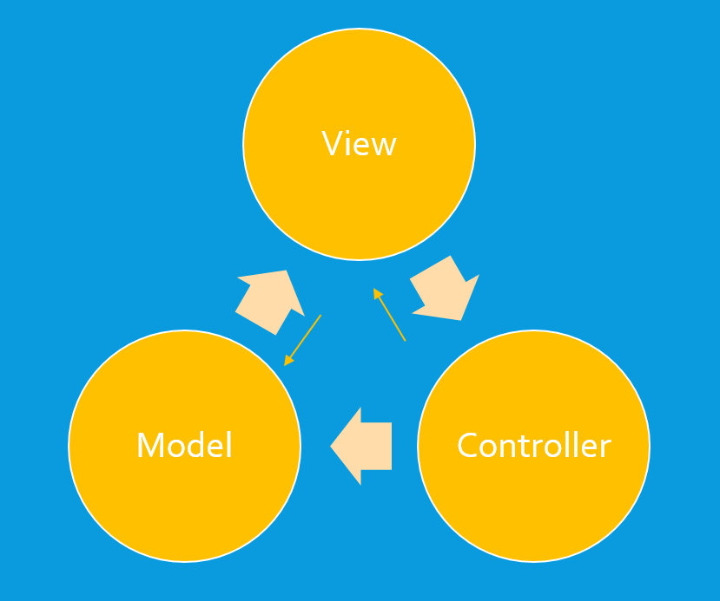
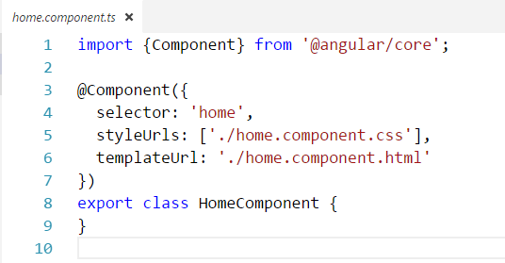
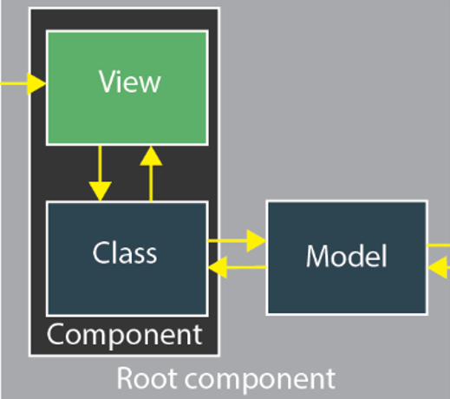
Components
An Angular App consists of a set of one or more [nested] component
@Input | @Output are used to exchange data
It defines:
  A selector
  View: HTML | Inline
  Directives
  CSS
  ...

